Slide 1


Understanding JavaScript Conditions
Created by
Anas Ismail

Slide 2
Introduction
Briefly introduce the concept of control flow in programming.
Mention the importance of making decisions in code.
01

Slide 3
'if' Statement
Explain the basic syntax of the if statement.
Provide a simple example:

Slide 4
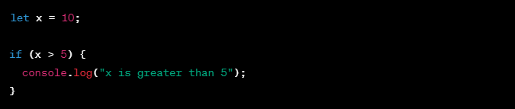
'if' Statement
Example:

Slide 5
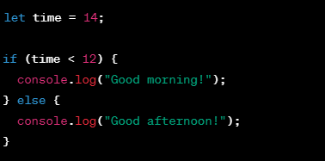
'if-else' Statement
Example:

Slide 6
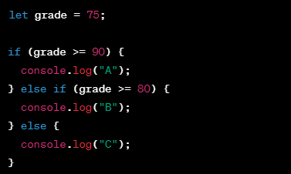
'if-else if-else' Statement
Example:

Slide 7
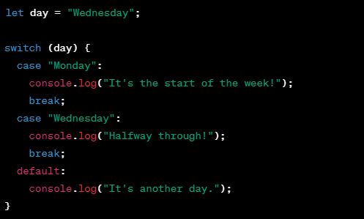
'switch' Statement
Example:

Slide 8
Differences Between 'if' and 'switch'
if
switch
more flexible and can handle a wide range of conditions.
more suitable for situations where you're comparing a single value against multiple possible values.
can be more concise and readable in certain scenarios
the compiler is dealing with “switch” better than “if”

Slide 9
Thank You

